Slide 1

Chinmaya Vidyalaya News
By your faithful reporters of Class XD

Slide 2


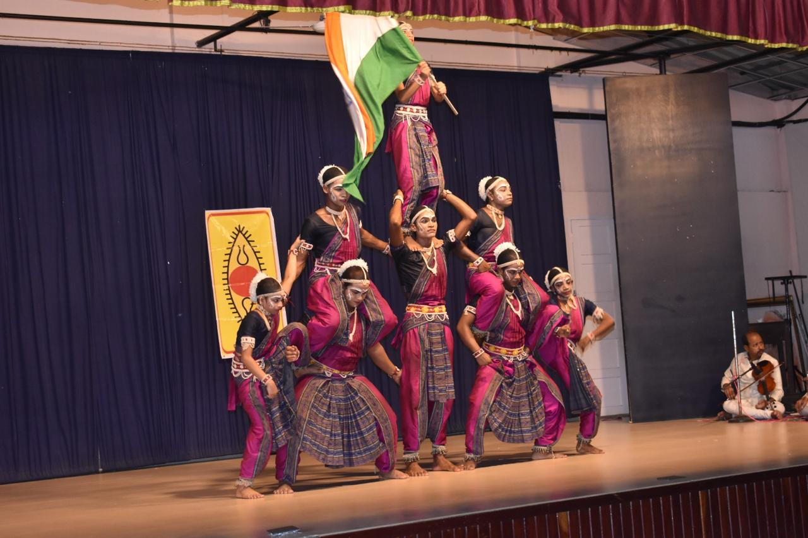
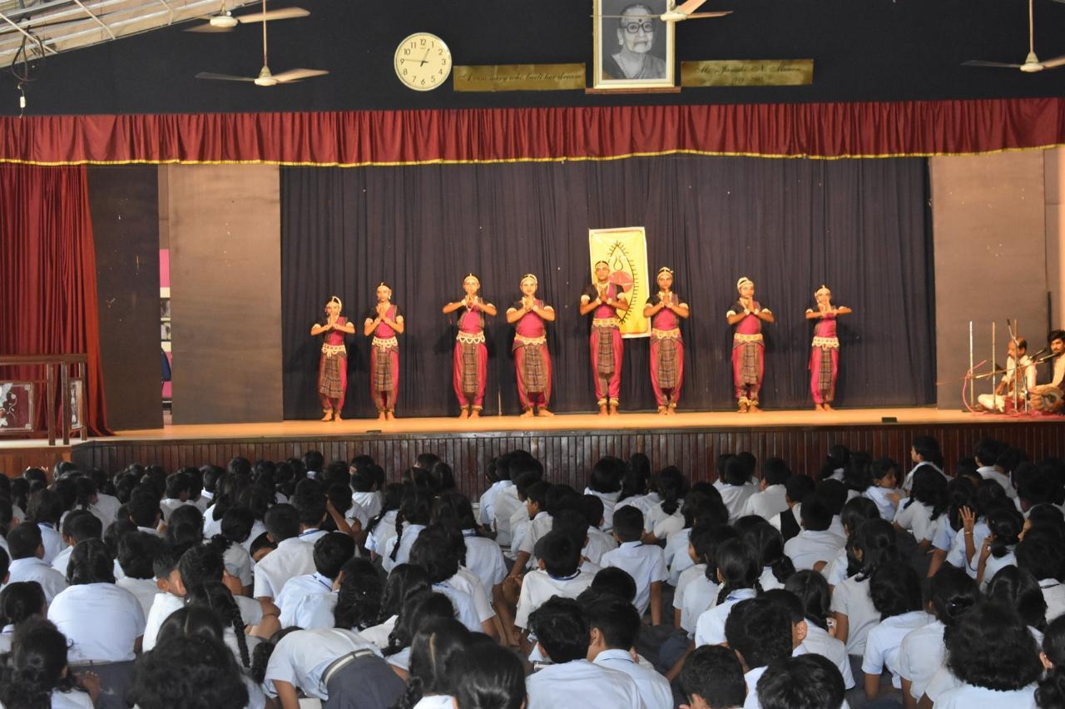
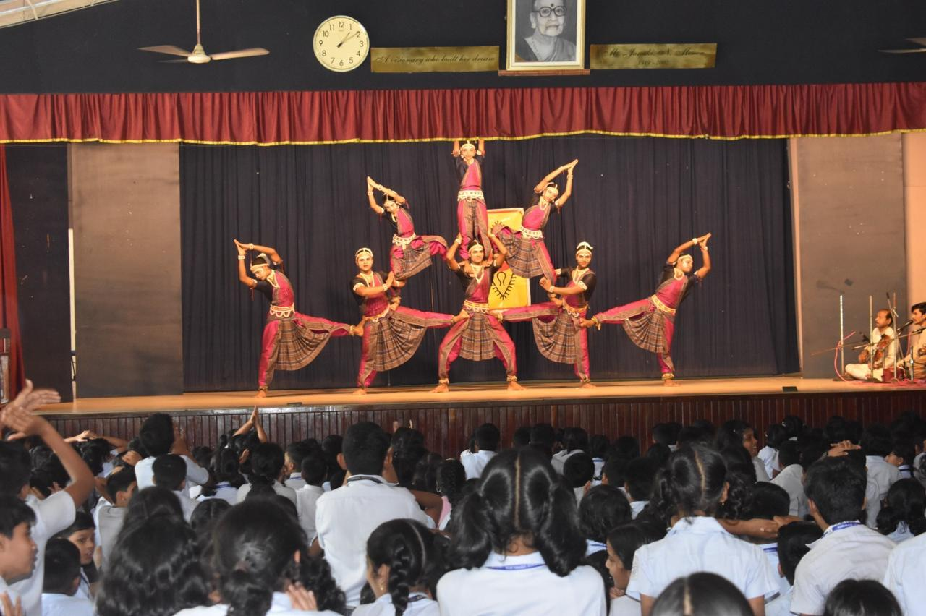
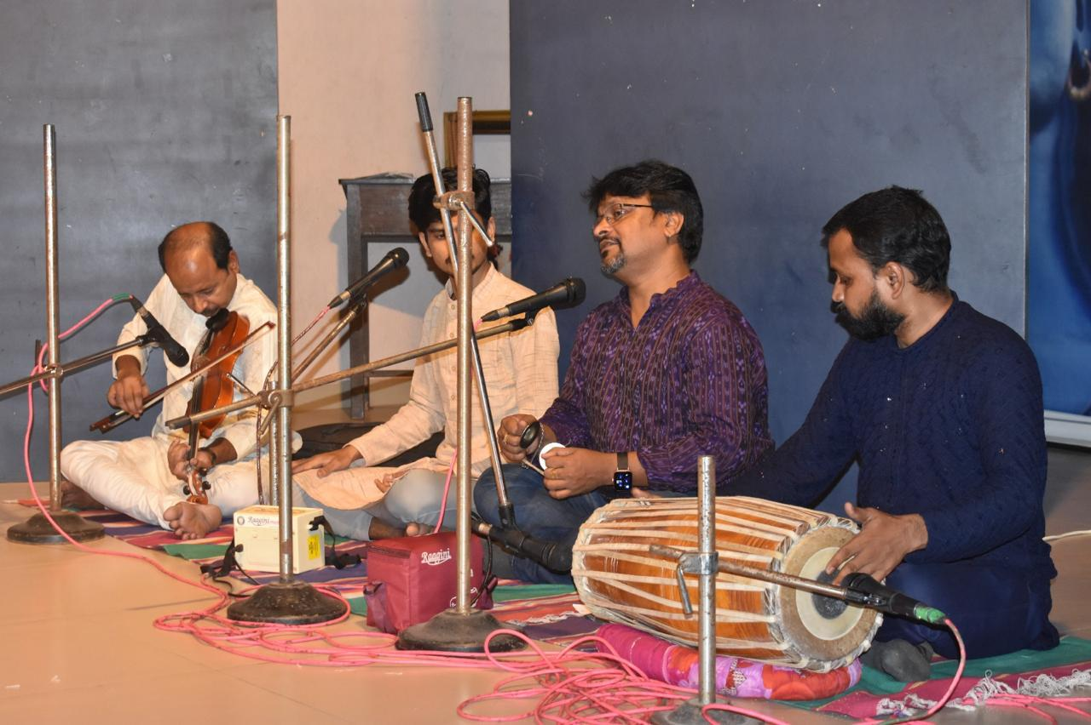
Spic Macay
The Traditional dance of Odisha, GOTI PUA was conducted in our school auditorium on 10th Wednesday last week.

Slide 3
That’s it folks! Thank you!

Slide 4


